Slide 1
Investigating a Method to Increase the Robustness of Predictive Steering-Control Autonomous Navigation Systems Against Dash Cam Image Angle Perturbations due to Pothole Collisions
AP Research

Slide 2
Topics Discussed
01
INTRO
02
METHOD
03
Preface the problem and explore the lit. review/gap
Process proposed for solving the problem
RESULTS
04
Data obtained from the method
CONCLUSION
Analysis and implications of results

Slide 3
Introduction
The average American drives 14,263 miles per year, amounting to 3.2 trillion miles driven annually.
Direct impact with a pothole could result in the equivalent of a 35 mph collision.
$26 billion is spent annually by drivers on pothole repair
1 in 10 drivers must repair their car after hitting a pothole.

Slide 4




Related Works and the Gap
Vibration
Analyze the jerk induced when hitting a pothole
Depth
LiDAR sensors to approximate the location of pavement anomalies
GPS
Consolidate pothole data on a central server
The Gap
Very little research on post-impact effects on the autonomous navigation system
Notes:
https://www.clipartmax.com/middle/m2i8K9N4N4N4i8Z5_pulse-clip-art-clip-art-vibration/
https://www.pngegg.com/en/png-cutyp
https://www.flaticon.com/free-icon/gps_856332
https://pngtree.com/so/gap

Slide 5
Method overview
01
Pothole Generation
Create 3D models for sample potholes
02
Statistical Analysis
Average statistics from 3D pothole samples
03
Image Perturbation
Apply statistics with assumptions to a real car

Slide 6

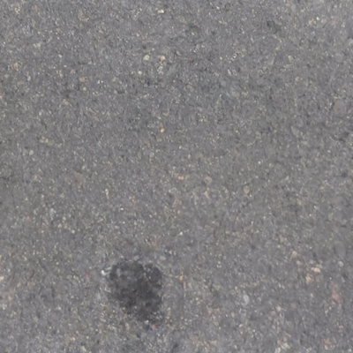
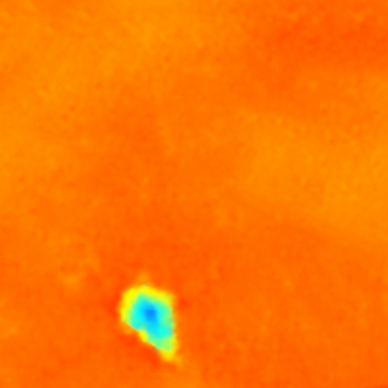
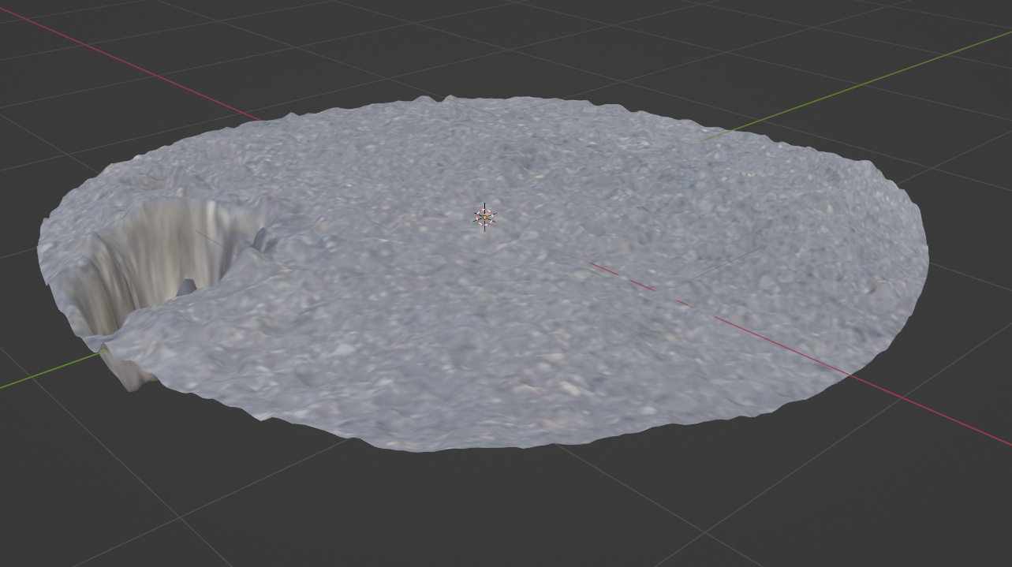
Method – Pothole Generation

Slide 7
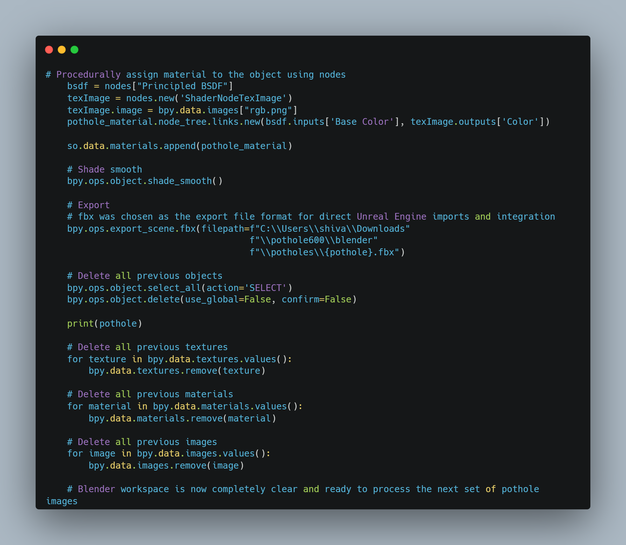
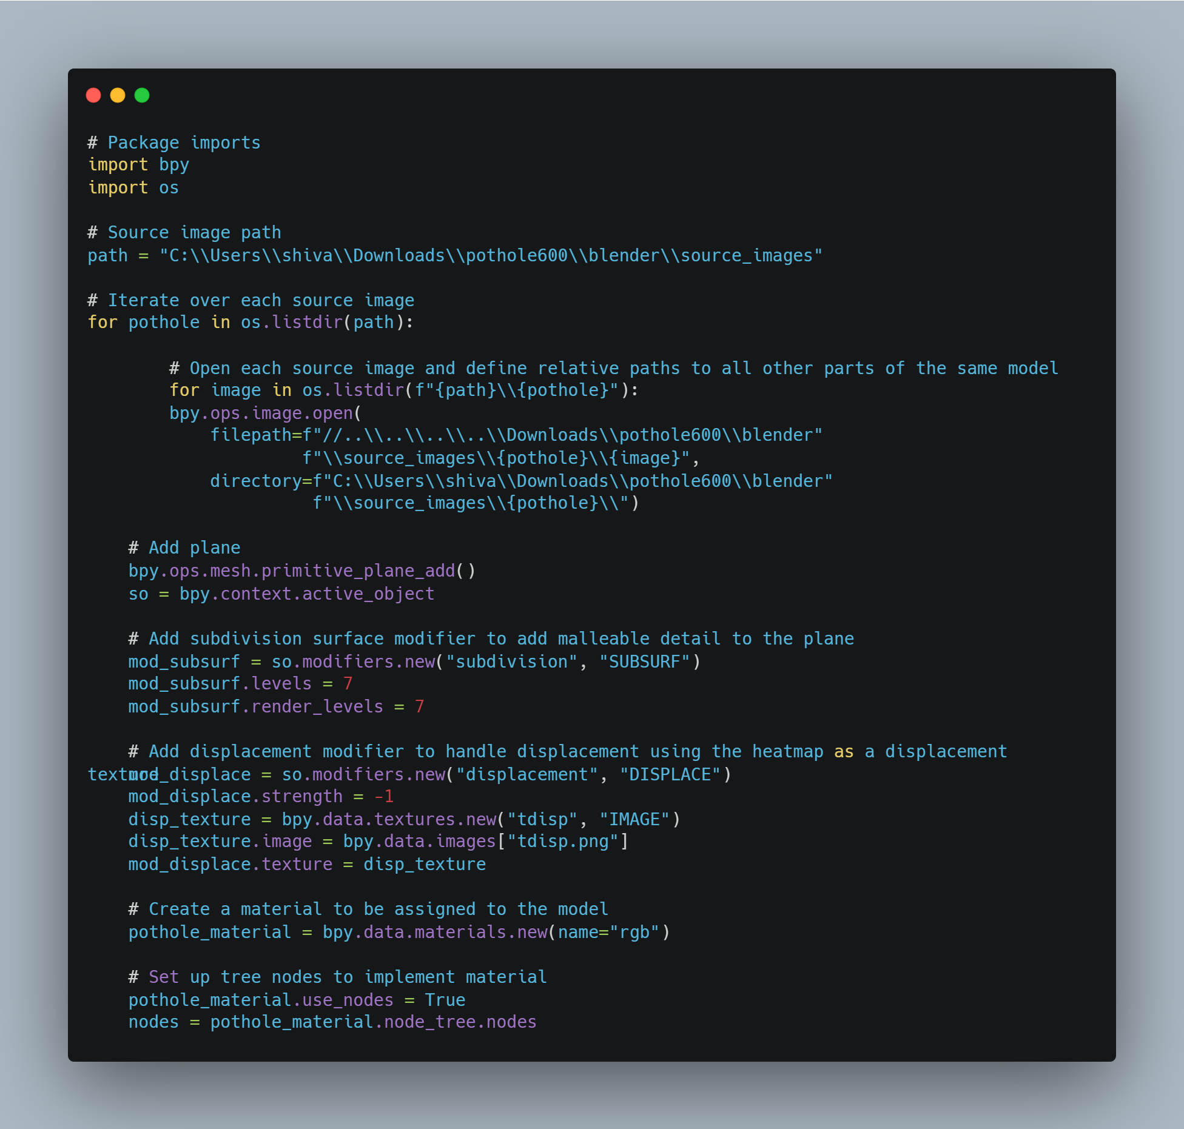
Method – Pothole Generation Code

Slide 8
Method – Statistical Analysis
Each pothole is split into a 10x10 grid of 100 subsections
We take the Average Slope of the model in three dimensions for each of the subsections
Combine average slope data for each of the 600 potholes into one large dataset of 60,000 values
Perform statistical analysis on the large dataset to obtain average statistics such as measures of variability and central tendency

Slide 9
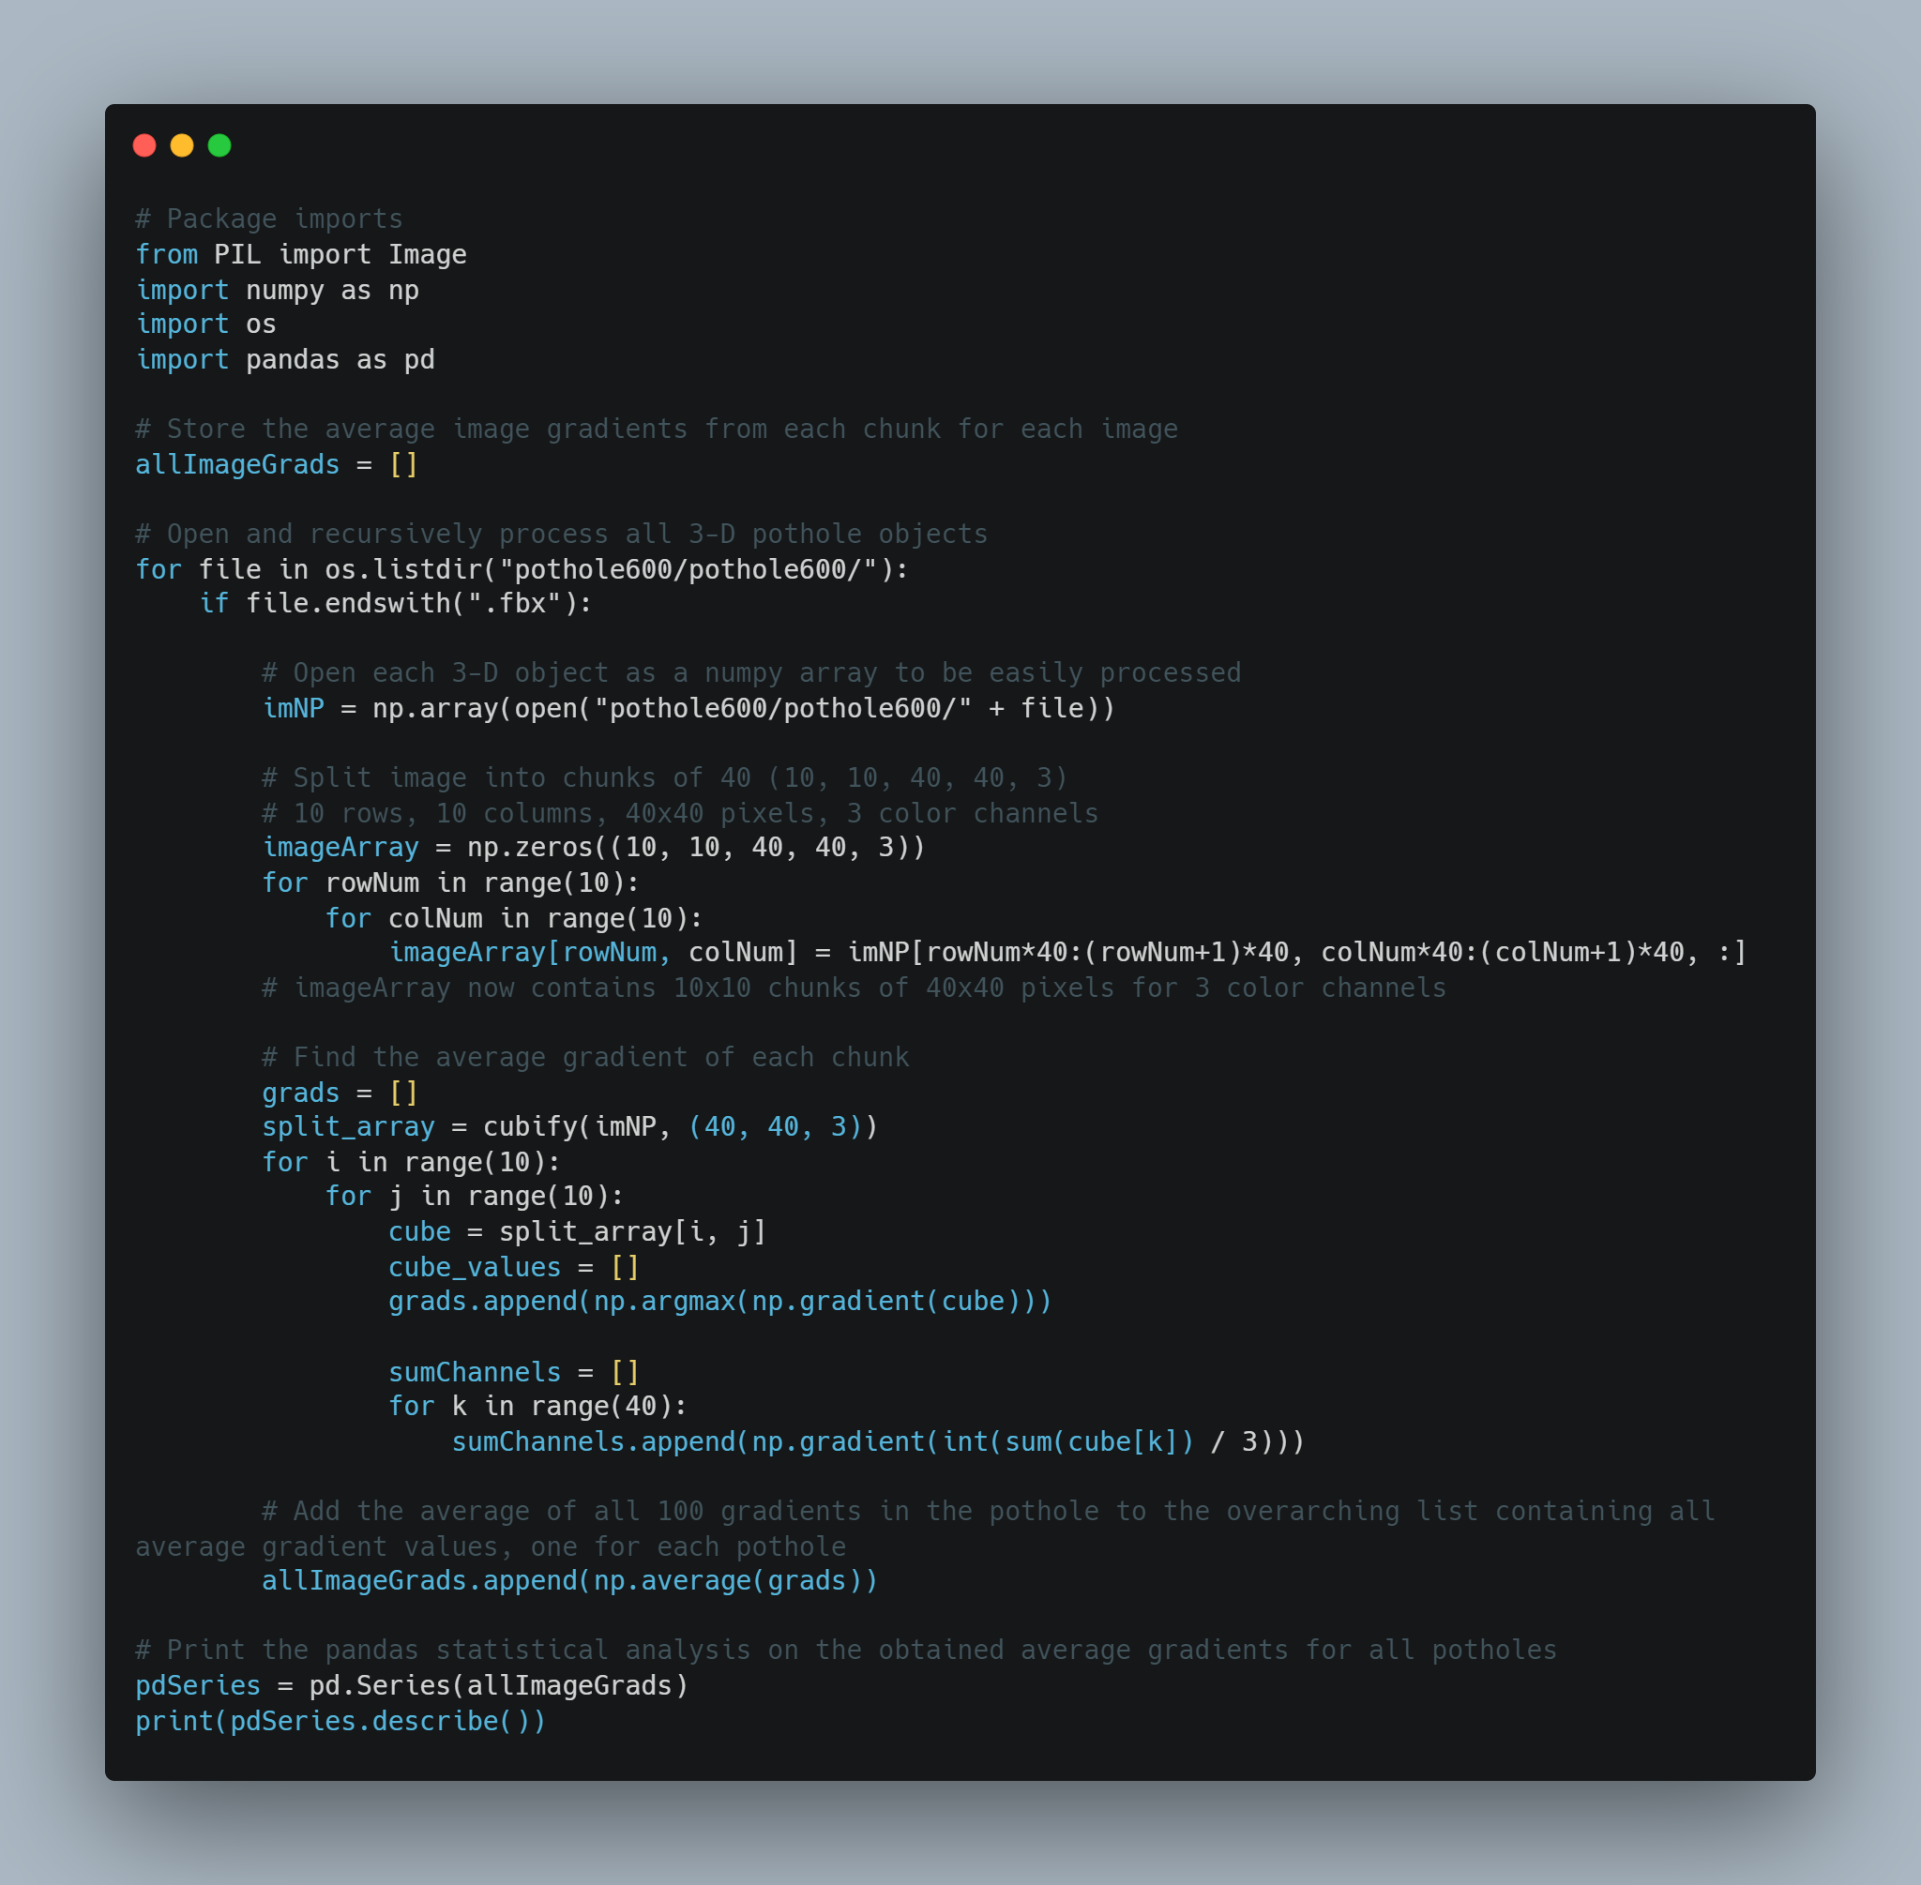
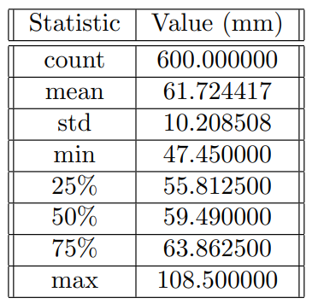
Method – Statistical Analysis Code and Results

Slide 10
Method - Assumptions
Pothole Sample
Assuming pothole sample represents target pothole population
Assumptions
Toyota Corolla
Rigid Body
1.12 million global sales 2022; 1.78m wheelbase width
Assuming no suspension

Slide 11
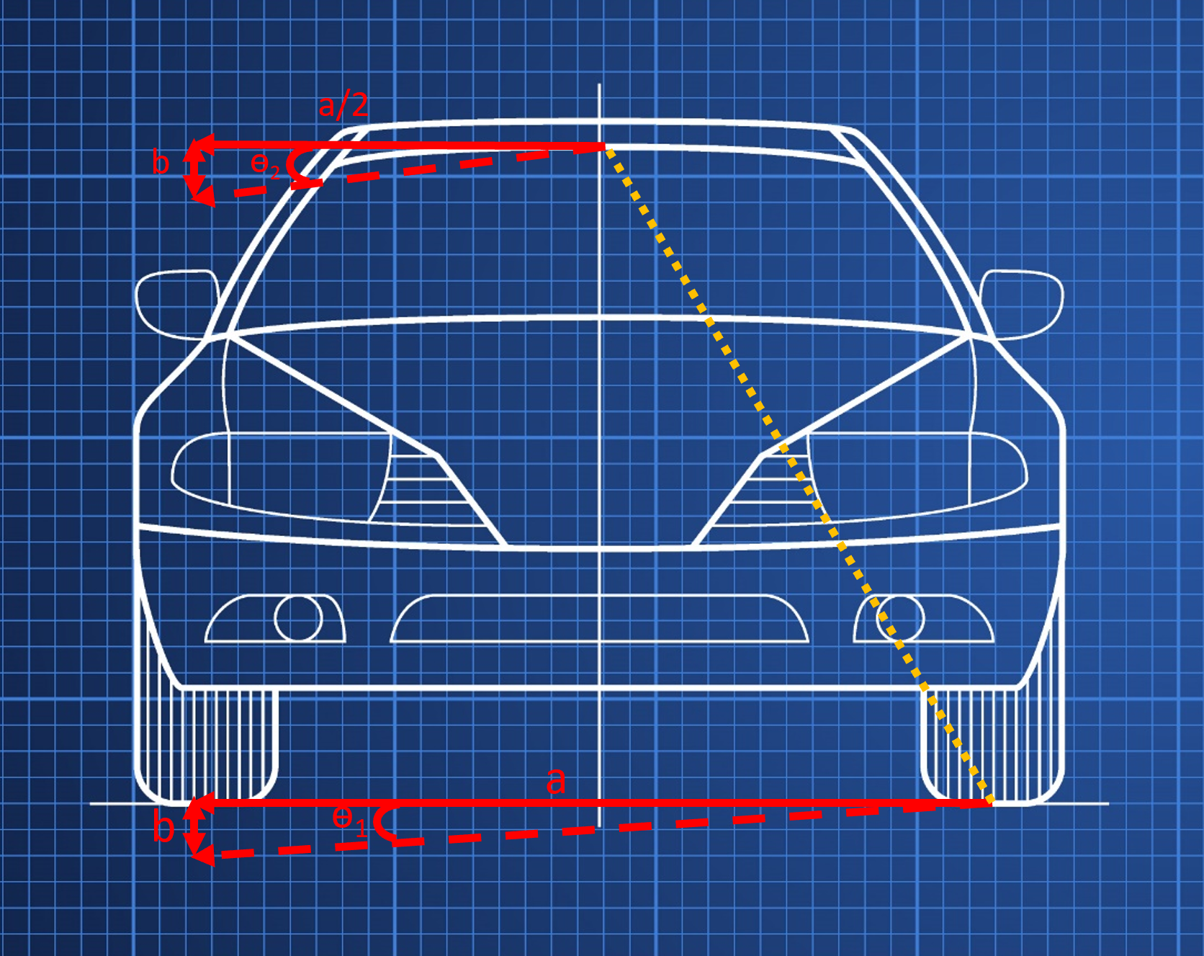
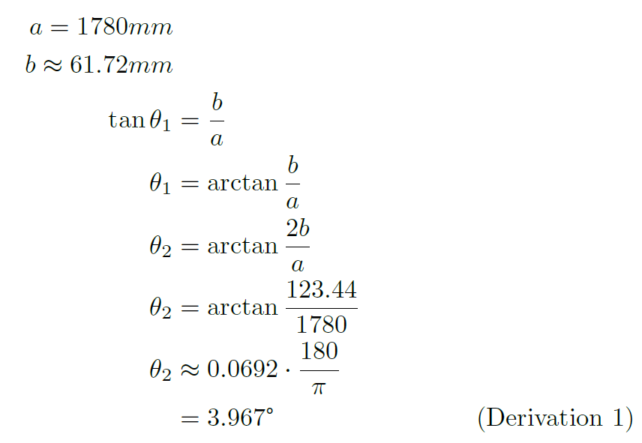
Method – Diagram and Sample Calculations

Slide 12
Method - Autoencoder
Custom-edited autoencoder built on Michael Villarreal’s AutoJoin
Autoencoders first reduce input images into low-dimensional representations
Autoencoders then learn to recreate the original image from the low-dimensional representation
Autoencoders are typically used in denoisers, in this case it will counteract a specific type of noise in dashcam images

Slide 13
Method – Autoencoder Parameters
Dataset of dashcam images provided by Audi and Honda, consists of 850,000 images
NVIDIA’s pretrained autonomous navigation model
Compare NVIDIA’s predicted steering angle before and after image perturbations
Optimize the model to obtain the same steering angle whether or not there are image perturbations

Slide 14
Method – Tools and Resources
Autoencoder trained and tested on 500,000 images for 50 epochs
High number of individual matrix calculations for image manipulation
Desktop with 32 gigabytes of RAM and an NVIDIA GeForce RTX 3090 with tensor cores optimized for matrix calculations
Each training cycle still takes the autoencoder over 12 hours of continuous runtime

Slide 15
Results – Evaluation Metric
AMAI Loss
Average
Mean Accuracy
Improvement
Average predicted steering angle
Percent alignment with true steering angle
Degree of increased robustness in the model

Slide 16
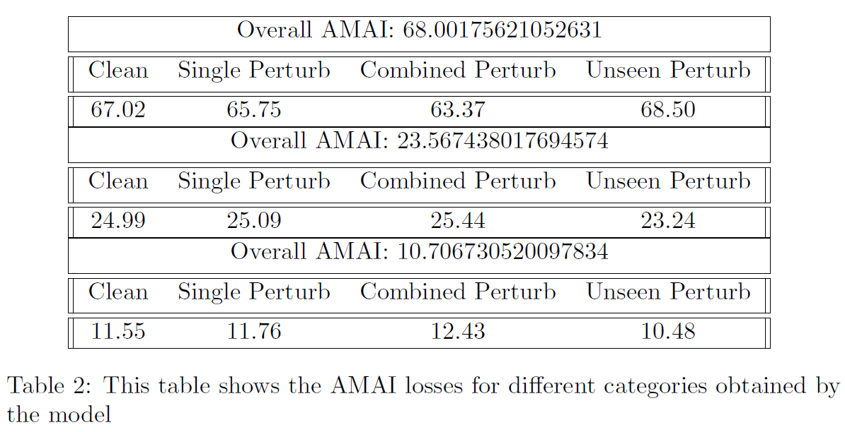
Results – AMAI Loss Output

Slide 17
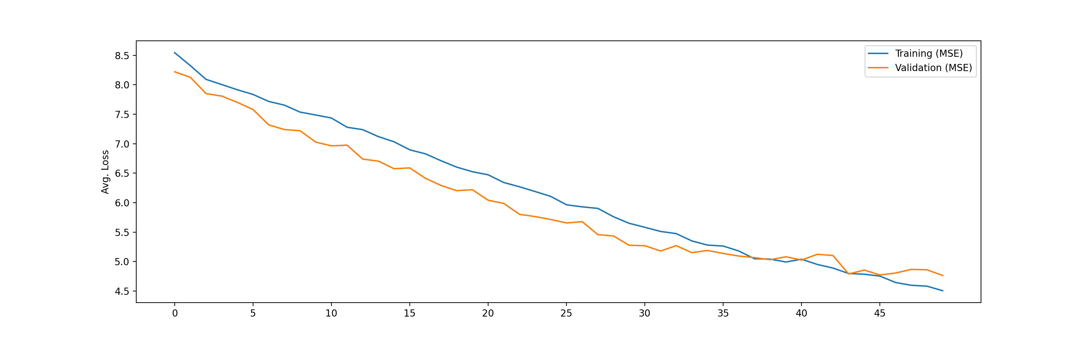
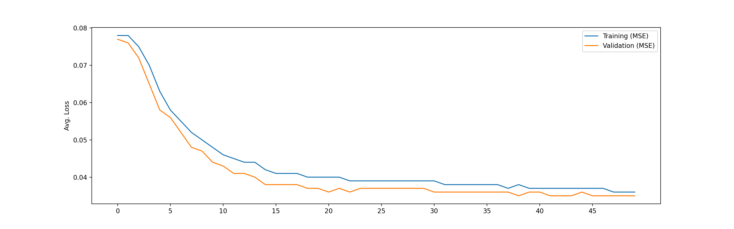
Results – AMAI Loss Graphs
Training Phase
Testing Phase

Slide 18
Conclusion – Goal and Contributing to Scholarly Review
Goal of this research project is to develop a method for creating robustness in autonomous navigation systems
From the significant decrease in loss over time, we can say that we have successfully achieved this goal within the scope of this research project
Technique serves as a backup in case of pothole collision if other researchers’ avoidance techniques fail
Cooperative interaction meaning that this technique does not interfere with most other approaches to solve this same problem

Slide 19
Conclusion – Assumptions and Limitations
Toyota Corolla used to represent the average car
Actual cars will have varying levels of suspensions
Entire method is tested only in simulation, no physical real-world testing
Pothole sample is not representative of a general population

Slide 20
Conclusion – Implications and Future Direction
Potential applications in Tesla’s Autopilot or similar pre-existing self-driving models
Increasingly larger numbers of companies are implementing camera-based adaptive steering control systems
Can investigate different types of road deformations such as speedbumps or different pothole collision situations
Physical testing to increase practicality of real-world implementation

Slide 21
Bibliography
[1] Blender’s history, Dec 2022.
[2] Carlos Bodden. Car accident caused by a pothole, what can you do?, Dec 2021.
[3] Blender Online Community. Blender - a 3D modelling and rendering package. Blender Foundation, Stichting Blender Foundation, Amsterdam, 2022.
[4] Ellen Edmonds. Aaa: Potholes pack a punch as drivers pay $26.5 billion in related vehicle repairs, Mar 2022.
[5] Rui Fan, Xiao Ai, and Naim Dahnoun. Road surface 3d reconstruction based on dense subpixel disparity map estimation. IEEE Transactions on Image Processing, 27(6):3025–3035, 2018.
[6] Rui Fan and Ming Liu. Road damage detection based on unsupervised disparity map segmentation. IEEE Transactions on Intelligent Transportation Systems, 21(11):4906–4911, 2020.
[7] Rui Fan, Umar Ozgunalp, Brett Hosking, Ming Liu, and Ioannis Pitas. Pothole detection based on disparity transformation and road surface modeling. IEEE Transactions on Image Processing, 29:897–908, 2020.
[8] MS Kamalesh, Bharatiraja Chokkalingam, Jeevanantham Arumugam, Gomathy Sengottaiyan, Shanmugavadivel Subramani, Mansoor Ahmad Shah, et al. An intelligent real time pothole detection and warning system for automobile
applications based on iot technology. Journal of Applied Science and Engineering, 24(1):77–81, 2021.

Slide 22
Bibliography
[9] Byeong-ho Kang and Su-il Choi. Pothole detection system using 2d lidar and camera. In 2017 ninth international conference on ubiquitous and future networks (ICUFN), pages 744–746. IEEE, 2017.
[10] Aniket Kulkarni, Nitish Mhalgi, Sagar Gurnani, and Nupur Giri. Pothole detection system using machine learning on android. International Journal of Emerging Technology and Advanced Engineering, 4(7):360–364, 2014.
[11] Zhaojian Li, Ilya Kolmanovsky, Ella Atkins, Jianbo Lu, and Dimitar Filev. Road anomaly estimation: Model based pothole detection. In 2015 American Control Conference (ACC), pages 1315–1320. IEEE, 2015.
[12] macrovector. Car blueprint. vehicle engineering blueprint. Illustration structure of sedan model, 2022. This diagram was designed using assets from Freepik.com.
[13] Susan Meyer. Average miles driven per year in the u.s. (2022) - the zebra, Mar 2023.
[14] Statista. Best-selling passenger car worldwide in 2022 (in million units), Jan 2022.
[15] Michael Villarreal, Bibek Poudel, Ryan Wickman, Yu Shen, and Weizi Li. Autojoin: Efficient adversarial training for robust maneuvering via denoising autoencoder and joint learning. arXiv preprint arXiv:2205.10933, 2022.
Thank you to SlidesGo for providing the presentation and infographic templates.

